Slide 1
Teensy 4.1
3 Pos Switch
Encoder
Pot.
Button
Button
Button
Switch
A
B
A
B
A
B
A
GND
vin
B
A
GND
Vin
A
Vin
A
B
B
19
18
17
16
15
14
13
12
11
ETH
Converter
(5v)
Vin
3.3V
21
22
GND
GND
20
23
Vi+
Vo+
Vo-
Vi-
Power Distribution (3.3v)
CAN Transceiver
22 AWG
Converter (12v)
VCC
GND
Tx
Rx
H
L
Vi+
Vo+
Vo-
Vi-
Serial Bus Servo Driver
STS3215
STS3215
STS3215
STS3215
14 AWG
20A fuse
Rx
Vin
Tx
GND
Sout
A
A
B
B
A
B
A
B
10 AWG
10 AWG
60A fuse
Power Distribution (+24)
Power Distribution (-24)
J16
J17
J16
J17
J16
J17
2
3
4
2
3
4
2
3
4
2
3
4
2
3
4
2
3
4
Odrive S1
Odrive S1
Odrive S1
25
26
J11
Power
J11
Power
J11
Power
27
28
29
30
A
B
C
+
-
25
26
27
28
29
30
A
B
C
+
-
25
26
27
28
29
30
A
B
C
+
-
Switch
6 AWG
175A fuse
out
AS5048A
BLDC
AS5048A
BLDC
AS5048A
BLDC
in
1
2
4
A
B
C
4
A
B
C
4
A
B
C
3
11
13
1
2
3
11
13
1
2
3
11
13
24V Battery
+
-

Slide 2
J1-3 (Base)
J4-6 (Elbow & Wrist)
3x 24V
5v
EE Sensors
CAN
UART
UART
Servo 3-5
Servo 1-2
PC Signal
Odrive 1-3
Encoder 3
Main Power
Robot cable
3x 24v
7.5v
Odrive Signal
Servo Signal
5v logic
UI Box

Slide 3
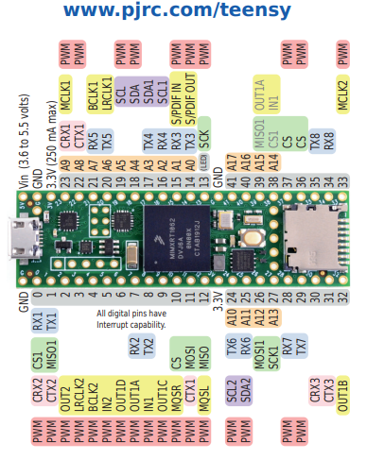

Slide 4
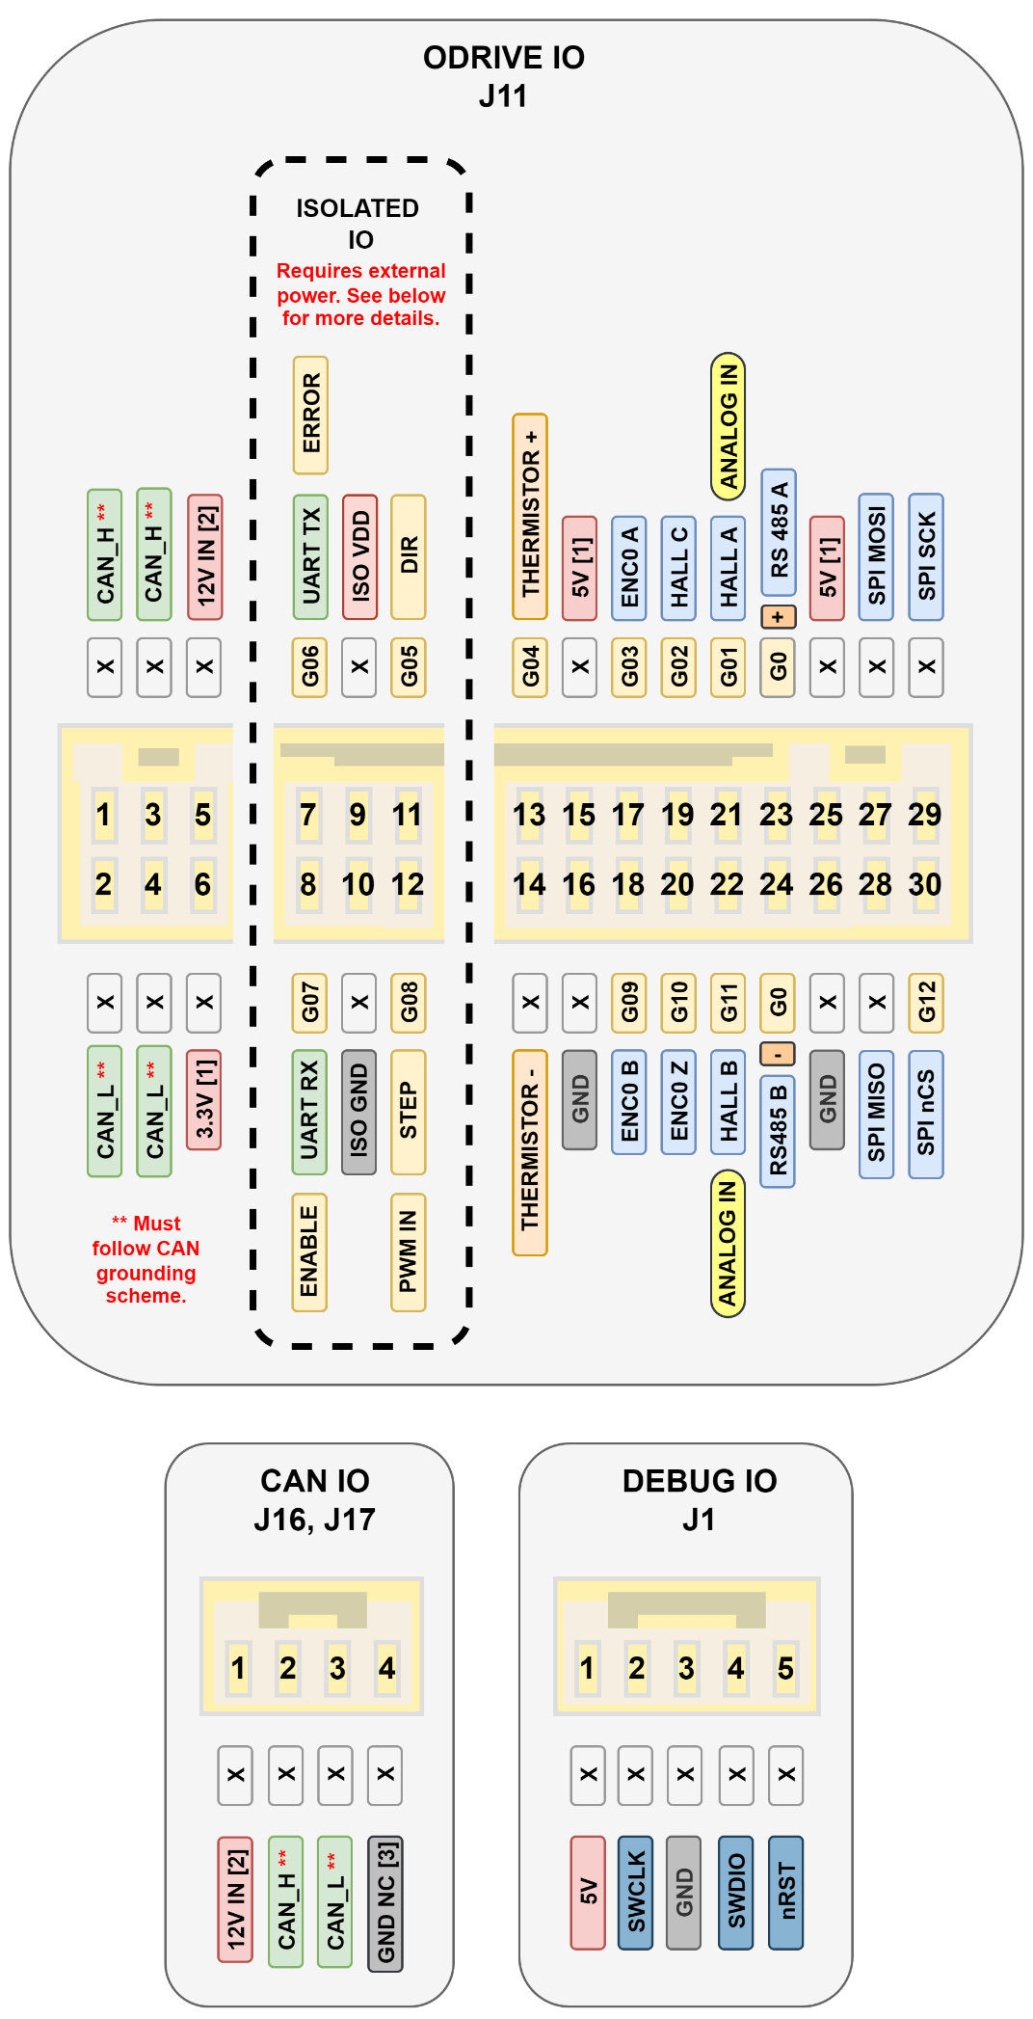

Slide 5
